Slide 1
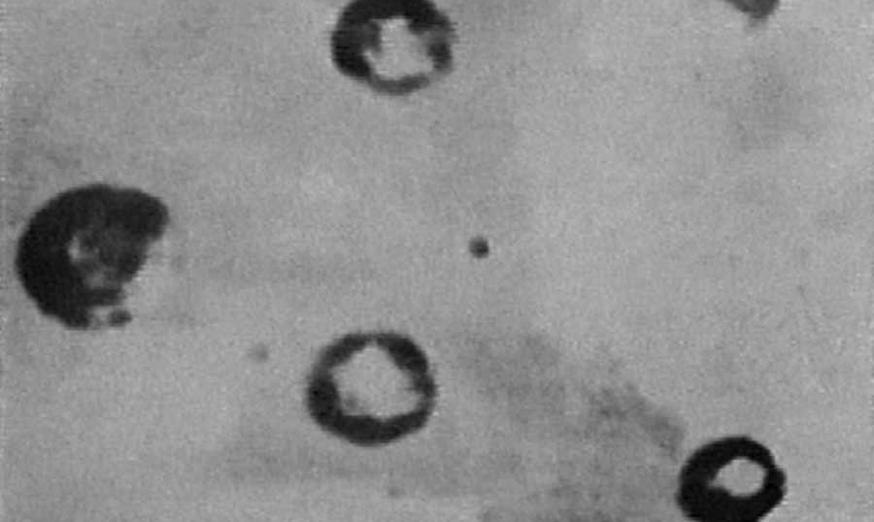
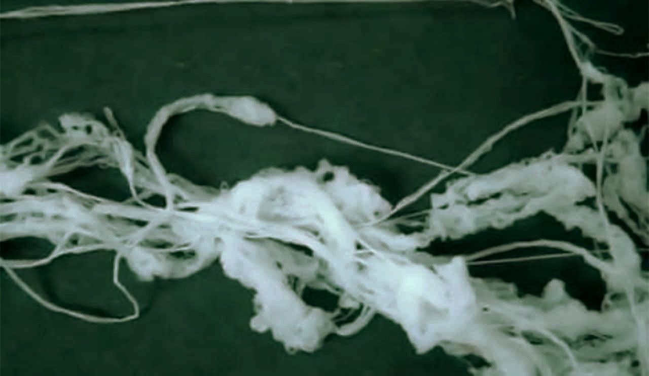
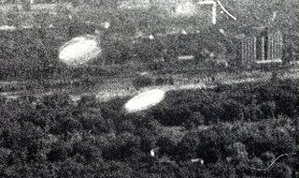
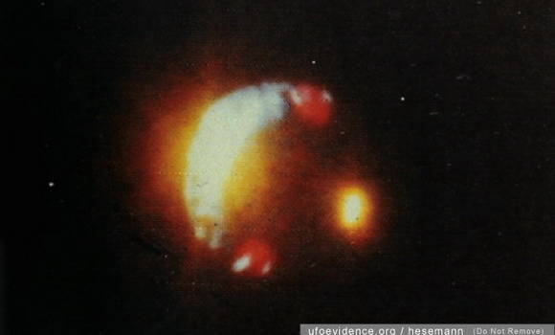
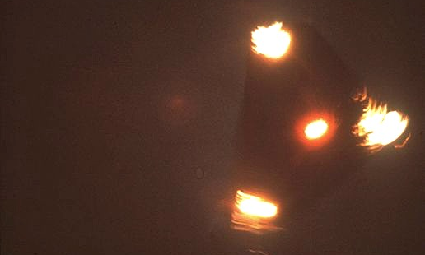
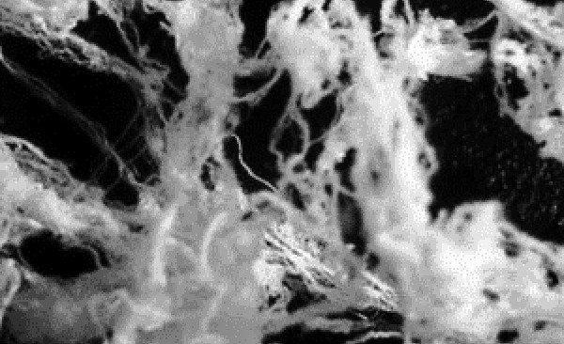
The “Angel Hair” (A.H.) Phenomena
Loose Angel Hair Photo 1
Farmington, New Mexico UFO Invasion of March 16-18, 1954
Hundreds of witnesses,
Angel Hair Mats On Bottoms
A Necessarily Interdisciplinary Explanation
which is testable by Science Now
Levittown, Puerto Rico UFO, 1980
Hundreds of witnesses, loitered over residences, Angel Hair Mat and Clumps
Hiawatha, Iowa Sept 3, 1955 over new housing development,
NOT lens glare, taken from low private plane,
Released Angel Hair Mat On Top
Jack Sliwa-Technologist 12/22/20
uapbehavior.com
uapbehavior@gmail.com
Petit-Rechain Belgium Triangle Invasion of 1988- 1990, Photo said genuine by several global experts, said fake by anonymous investigator 21 years after incident,
Released Angel Hair Clumps
Loose Angel Hair Photo 2
Prepared for podcastufo.com
For educational purposes only

Slide 2
What do we know for certain?
A.H. is the the falling of whitish fibrous material on land and sea, from typically silent UAPs which pass or have passed within sight or overhead. A.H. falls can last 1-3 hours even after the UAP leaves!
Hundreds of cases have been recorded across the globe and across time. No spiders or caterpillars are found in fibers from real A.H.
Many A.H. cases include wads or strands of visibly UAP-dropped A.H. draped on trees, fences, barbed wires, roofs, sports fields (with players and fans coated) and buildings and extending for miles
In more than half of cases the A.H. “sublimates” as rapidly as 2 to 20 minutes with no visible residue, stain or vapor. Sometimes it sublimates in full view even before it very slowly reaches the ground. Spider web, on the other hand, does not sublimate or disappear-it is very stable. During some UAP flaps 100% of all fallen A.H. at all such A.H. flap fall locations sublimates.
Minimal A.H. smell (if any), some noted mild hydrocarbon or camphor smell, flammabilty is like cellophane or glycine/celluloid. Detected Camphor is an atmospheric terpene as well.
A.H. is very stretchable (e.g. 2-2.5X or more) and strong; finger contact always turns it to a gel
The Peak A.H. season is during Fall (northern and southern hemispheres 6 mos apart. This means presence of average cool and moderate-humidity weather

Slide 3
Indicators Of True Angel Hair
True Angel Hair actually from UAPs is, as of today, indicated by:
Actually being seen shooting off-of, falling-from or matted-upon UAP surfaces
A.H. usually “sublimates” quickly at ground level in free air whereas spider web is very stable
A.H. is hydrophilic and turns to a hydrogel in water/rain/fog whereas woven spider web is extremely rain resistant (or spiders would be extinct!)
A.H., to date, contains Boron and Silicon whereas spider web does not
Fallen A.H. from ballooning spiders is typically covered with hundreds of spiders while A.H., with one exception wherein one spider was found (trapped?), has no spiders
(f) A.H. has stained fingertips green unlike spider web material
Spider web melts but doesn’t burn or energetically flame up like A.H.
Real A.H. appears as rough mixed round, oval and rectangular string, some cross-fused, or “knitted”, whereas spider web appears as mostly smooth round wire bundles (later slide)
Subtle variable FTIR differences from Spider Web? Probably need additional instrument types to discern
A.H. is formed 100-1000x faster than spider web-and it shows in the ragged wildly varying fiber quality and shapes

Slide 4
What do we know for certain?
Over the years several A.H. samples across the globe have been properly scientifically analyzed (using mass spectroscopy) and all contained silicon, calcium, magnesium and boron inorganic residue. Some types of spider web contain calcium and magnesium (as does most any living matter and earthly soil/rocks) but spider web does NOT contain significant boron or silicon inorganic residue.
None of the 7-12 compositions, microstructures or different “weaves or layups” of spider web sublimate or evaporate. All are hydrophobic and quite stable even at dry oven hot temperatures.
A recognized corporate textile company fiber-expert (Burlington Corp) stated that that A.H. he examined was NOT manmade fiber of any sort
Spider web is extremely hydrophobic at-least on its protective surfaces. If spider webs passively (without mechanical or chemical help) gellated like A.H. in the rain or fog then spiders would be extinct!
A.H can be preserved at-least for days/weeks if hermetically sealed in a small glass container and kept substantially cooled or frozen. If the container isn’t protective then only trace magnesium, calcium, silicon and boron nanoparticles (likely nanoparticle oxides from interstellar/tropospheric dusts and ice particles) will be found at exact spots where the A.H. contacted the inside of the bottle. Even that is exceedingly difficult to isolate since most glass itself often contains such species.

Slide 5
What do we know for certain?
A.H. fibers occasionally have localized droplets along their lengths and can be frequently forked (split fibers). The same as for rapid A.C. electrospinning.
A.H. fiber diameters and shapes can vary along their lengths or vary between adjacent fibers. The same as for A.C. electrospinning.
A.H. fiber bundles almost appear as knitting and show variable interfiber and intrafiber fusing. The same as for A.C. electrospinning (much less for DC spinning with collector).
Compressed adhered A.H. fiber mats have been observed stuck to UAPs. A.C. electrospun fibers are also easily matted by a resisting wind or their own inertia if not extracted properly-as by pulling for example
Fiber emission seems to happen most often for very low and slow travelling or hovering UAPs (which probably prevents immediate fiber shredding)
A.H. has visibly fallen from huge cigar motherships, disks and sphere UAPs. Several of these events had hundreds to thousands of witnesses, some of whom collected samples and had them analyzed
Sudden or slow and steady UAP acceleration can cause fiber emission as can two close-by spherical or Saturn scout-ship UAPs (from a parent mothership cigar) moving apart from each other wherein fiber forms between the separating scout ships

Slide 6
What do we know for certain?
Helpful analytical data on A.H. specimens has been reported by Phyllis Budinger of Frontier Analysis Ltd of Ohio. She has clearly demonstrated (1)-(3) below using several specimens from different A.H. and Spider events:
1) A.H., when UAP are seen, has a quite similar BUT DEFINITELY DIFFERENT FTIR spectrum than spider web references
2) Several “A.H. specimens found without a UAP being seen have perfectly matching A.H. FTIR spectra-are likely A.H.
3) Spider web finds match the spider web reference and NOT the A.H. spectra-not surprisingly
The author (J.S.) notes that an amide linked protein (as for spider web) are found in meteorites as are almost 300 hydrocarbons including amino acids and glycine sourced celluloidal material. And the upper atmosphere contains several fatty long-chain acids (and thousands of hydrocarbon species) including palmitic acid as found soaked onto a fallen fibrous burning UAP debris portion (P. Budinger report UT087)
Further, spider web in microphotos appears much smoother, more uniform and less cross-fused than angel hair in microphotos which makes sense since spiders have excellent control and 100-1000X slower spinning
Photos: from
P. Budinger
reports
Spider Web usually
looks like wires with a
few frayed ones (JS)
Angel Hair usually
looks like string or
sloppy knitting (JS)

Slide 7
What do we know for certain?
A.H. fibers are typically around 0.23-5.0 microns in diameter (a human hair is about 100 microns or .004 inches in diameter or 4 mils)
A.H. fibers can be up to 30-50 feet long-usually comprising multiple strands
A.H. fibers are usually locally fused to neighboring fibers in bundles for portions of their fiber lengths
A.H. fibers are usually roundish in section but can occasionally even be rectangular (likely at at very high growth rates with residual solvent) Spider webbing isn’t rectangular.
Almost all A.H. fibers are white amorphous (milky) looking and then become more shiny and translucent upon stretching. This is likely crystallization during straining-a known explainable polymer behavior
Occasionally, A.H. fibers can be gray, more rarely black and were once green while falling on a schoolyard
Several witnesses have had their fingers and hands stained green from handling fresh whitish A.H.
A.H. is tacky to the touch-evolving to goo (hydrogel probably) with manipulation by the fingers
A.H. is not foul-tasting, disabling or poisonous –at least in a minute amount
Spider Web comprises mainly the amino acids glycine, proline and alanine. Glycine has been found in space. Alanine and proline have been produced by NASA in vacuum chemistry space simulation experiments with UV plus ice particles AND are found in many meteorites (indicating interstellar dust origin). Glycine, proline and alanine are also found in rain water originating from atmospheric dust.
Thus the exact spider web constituents (plus thousands of other simple and complex chemical species per next slides 8 and 9) are found in the upper dusty atmosphere and in dusty interstellar space (probably since even before spiders evolved)

Slide 8
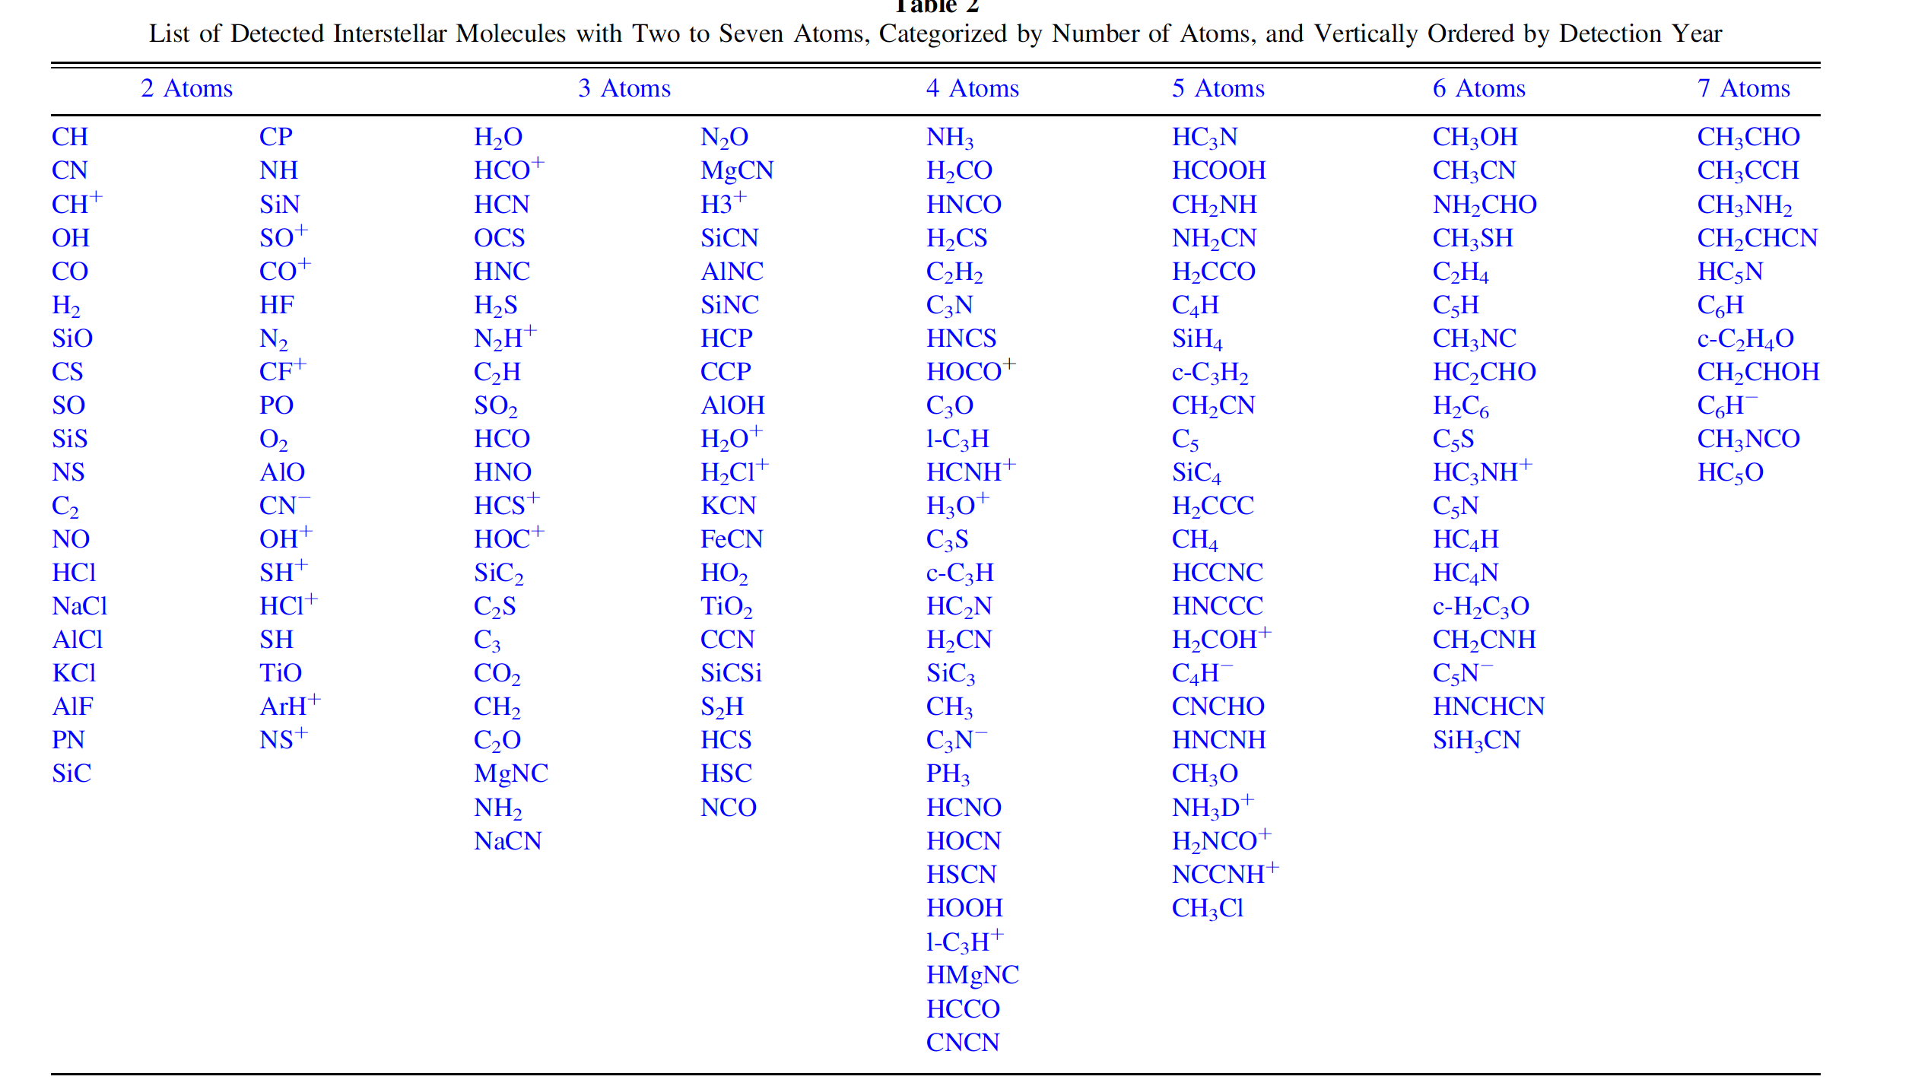
Hydrocarbons and Prebiotics Existing In Space/Meteorites/Comets-A Growing List
A Few More Recent Increasingly Large Prebiotic Molecules
Glycine on water ice NH2CH2COOH (simplest amino acid)
Glycine can be backbone for amino acids alanine and serine
Above amino acids are found in many meteorites
Alcohol plus ammonia plus UV or bombardment yields amino acids
Methyl Formamide CH3NHCHO
Cyanamide NH2CN
Formamide NH2CHO (simplest amide). RC(=O)NR′R″
Acetamide CH3CONH2
Sugar Glycolaldehyde CH2OHCHO (simplest sugar)
Urea NH2CONH2
Numerous RNA precursors-nec. for building protein polypeptides
Protein polymer amide in meteorites-hemolithin protein from glycine, capable of splitting water

Slide 9
Example Species Existing In The Atmosphere
Some Chemical Species Naturally In The Air (not pollutants):
BrO- hypobromite, CCl4 carbon tetrachloride, CH3Cl chloromethane, CH3OH methanol, CH4 methane, CO carbon monoxide, CO2 carbon dioxide, COF2 carbonyl fluoride toxic, C2H2 acetylene, C2H4 ethylene, C2H6 ethane, ClONO chlorine nitraate, CF4 carbon tetrachloride, C8H6O2 , C6H8O2 terephtalaladehyde, 3,4 dimethyl-2-butanoic acid gamma lactone, C9H14O isophorone, C8H16O2 ethyl-hexanoic acid, C10H14N2 nicotine, C10H16O2 pinon-aldehyde, C8H4O3 ophthalmic anhydride, C9H18O2 nonionic acid, C11H22O3 methyl decanoate, C12H24O3 decanoate, C13H26O3 methyl dodecoate, C15H24O2 farnesoic acid, C15H30O3 methyl myristate, C16H22O4 dibutyl phthalate, isoprene, C16H32O3 methyl pentadecanoate, C17H34O3 methyl palmitate, C19H34O3 methyl linoleate, C19H36O3 methyl oleate, C19H38O3 methyl stearate, C21H44 heneicosane, C22H46 docosane, C23H48 tricosane, C24H50 tetracosane, C26H54 hexacosane, C27H56 heptacosane, C28H58 octacosane, camphene, 3-carene, p-cymene, ethyl benzene, gamma-terpinene, H2O water, HCHO, HCl, HCN, HCOOH, HF, HNO3, HOCl, iso-propylbenzene, limonene, methyl-chavicol, myrcene, N2 nitrogen, NH3 ammonia, NO, NO2, Nonane, Nopinone, N-propybenzene, Nox, O2 Oxygen, O3 Ozone, C10H16 Ocimene, carbonyl-sulfide COS, hydroxide OH, alpha-phellandrene, alpha-pinene, beta-pinene, O-xylene, p-xylene, sabinene, SF6, styrene, alpha-terpinene, terpinene-4-ol, terpinolene, alpha-terpineol, 1,3,5 trimethylbenzene, 1,2,4-trimethylbenzene, inorganic chlorine, inorganic fluorine, fulvic acids (on HULIS)
Some Esters In The Atmosphere:
citronellal formate, cinnamon acetate, ethyl acrylate, coniferyl benzoate, >8 organophosphate esters
Some Atmospheric Oxidized Terpenes-Many Form Viscous Liquids and Polymerize
>45 Oxidized Terpenes such as: 2-2 dimethyl 3 acetyl, pinon-aldehyde, pionic acid, 6,6-dimethyl-bicyclo-hept-2-one, aldehydes, carboxylic acids (e.g. palmitic, oleic, stearic), carbonyls (e.g. HCHO,CH3CHO, CH3COCH3), Beta-caryophyllene, alpha-cedrene, alpha-cedrene, alpha-copaene, formaldehyde, acetaldehyde, formic acid, alpha-humulene, methacrolein, methyl-vinyl-ketone, 4-acetyl-1-methicyclohexene, limonene-oxide, linalool, methyl-chavicol, nopinone
Terpenes polymerize and oxidize especially with Ozone, OH-, UV and nitrates
-Carboxylic Acids in Air Plus Atmospheric Plasma Produce Esters, Carboxylic Acids Coat Atmospheric Ice and Inorganic Dust Particles
-HULIS-Humic Like Substances (biggest organic aerosols with typically low volatility found globally)-incorporate Fulvic Acids and Contain Organonitrates, Calcium and Magnesium
-10exp8 tons/yr Atmospheric Species emitted/formed
-Can be collected from static air using sorbents and small pump in as little as 5-7 minutes despite low ppb concentrations
-Found at UAP landing Sites: formic acid, oxalates (eg ozone plus ground calcium), fulvic acid; Found in A.H.-carboxylic acids, esters, trace nitrates, many other hydrocarbons, celluloidal matl (glycine)

Slide 10
What isn’t the explanation ?
No known or anticipated human designed aviation, aerospace craft, probe, balloon, aerostat or missile can explain:
Silent hovering AND then accelerating extremely rapidly away
Silent hovering in the wind
Collecting the herein-suggested interstellar agglomerate over huge distances (one must get out of the heliosphere-billions of miles away)
Collecting the herein-suggested upper-atmosphere agglomerate without it burning due to hypersonic or supersonic heating necessary to sweep huge distances
Observing a silent UAP with rapidly emitting torrents of sublimating fibers
Occasionally there have been suggestions, some from very learned individuals I respect, that what witnesses are seeing are “holograms” projected by aliens or unknown intelligences. That doesn’t account for the physical evidence. UAPs ARE physical for periods at-least while here
Why would A.H. expelling UAP leave any physical evidence at all? (a) because A.H. is unavoidable, (b) because UAP crews feel that we already know they are not from earth, (c) because “ET’s” fundamentally don’t fear us
Neither Spiders or Caterpillars, nor their genes, are the source of real A.H. per Slide 2

Slide 11
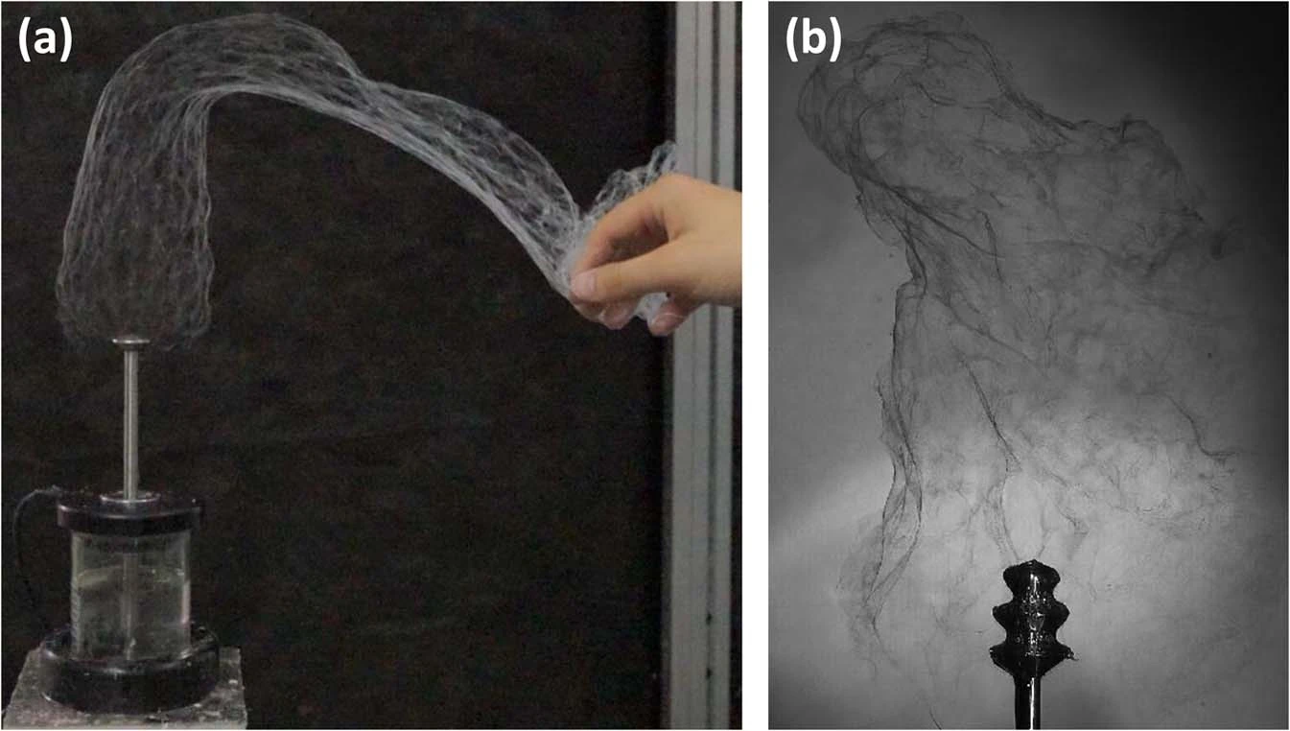
AC Electrospinning- the core explanation for A.H.
Fiber plume
electric wind/corona
and fiber mat momentum
and mechanical pushing/pulling
Spin head
32 kv AC
50 hz
Spinnable solution

Slide 12
What is the explanation ?
Fiber emitting UAPs have large AC voltages at-least on their emitting hull portions-this has been known for decades and is absolutely no surprise. Likely the needed 10-75 khz, likely 15-40kvolts
The A.H. emitting driving force is the same as for human-industrialized AC electrospinning, possibly further aided by diamagnetic spinning. (most of the emitted constituents are net-diamagnetic as well allowing fibers to also be diamagnetically repulsed from the hull)
The emitted fiber material must first be collected (pre-emission) as an agglomerated hull coating in
interstellar space (as ice coated inorganic dust and waxy hydrocarbon coated ice or dust)
and/or in the upper atmosphere as atmospheric aerosols based mostly on thousands of known terpene-derived unoxidized and oxidized (SOA) hydrocarbons plus falling interstellar dust and elevated earthly dust
A.H. fiber emission is from the agglomerated hull coating itself, no coating means no fiber emission regardless of AC voltage, magnetic Fields, UAP-intent or season
The instability (sublimation) of A.H. is most likely accounted for by one or more of interstellar space/upper atmosphere sourced UV, X-Rays, Gamma Radiation, Cosmic Radiation, Microwave Exposure, trapped charge (electrons, ions, radicals)
Further, it is known that a UAP plasma envelope contains highly reactive species including metastable radicals and ozone. Hydrocarbons are attacked and/or cross-linked by these species as well as many of the radiation types above.

Slide 13
What is the explanation ?
Almost without exception A.H. is inadvertenly emitted by A.C. electrospinning as quickly tangling and fusing fibers. However there have been at least a couple of spectacular also-explainable exceptions which I argue further strengthen the case for the more typical A.C. electrospinnng explanation herein. Here is one such case.
The UAP emission of sublimating flakes of A.H. material was witnessed from a disk type UAP appearing at Fatima in 1917 Portugal to a crowd of 17,000 citizens, priests, legal people, civil servants, newspaper reporters, a few scientists and the three targeted children (Regarded as a miracle by the Catholic Church). The author explains that if a disk type UAP purposely spins fast enough while having an agglomerated film of A.H. starting-material then instead of A.C. hair emission one would get radially flung droplet emission-said flakes or “petals” falling to the ground appreciably faster than hairs and still “sublimating”. That is what happened at Fatima. That is essentially like some known electrospraying methods.
The author believes the Fatima UAP crew (present or remote or as AI) did this purposely along with its fantastic and blinding color changes and a terrifying concluding dive toward the assembled witnesses. The UAP’s dive was of the historic UAP-unique manner of the “falling leaf” type which is clearly explained on my website uapbehavior.com Also noted was the exposure of the crowd to very likely microwave radiation which quickly dried their clothes and the ground of rain.
I won’t comment on the potential religious or spiritual aspects of that event as I am not qualified to do so (you can find such discussions on the internet occasionally intelligently articulated as potential explanations of UAP motivation). I am however certain that this was a UAP planned occasion to make a serious lasting impression on the preassembled populace and upon the earthly powers of the day. It most certainly did-at least for a while.
Anyone doubting that event should read up on the numerous newspaper stories and investigations of the time.

Slide 14
Where do they (A.H. Craft) come from ?
UAPs which visibly emit Angel Hair are not designed or produced by humans. Their crews or overseers, whether present or remote, likely have on-going experience with many other “earths” in various stages of evolution.
By “visitors” I mean crewed craft or remotely (or AI) operated craft seen here at Earth. UAP may take extended stays (or shifts) here -residing or hiding in our oceans, solar neighborhood or even in the solid earth (earth is NOT hollow):
Speculations- my personally estimated probabilities:
(a) Intragalactic Visitors traveling at relativistic velocities with proven on-board time slowing. They may take extended stays (or shifts) here residing or hiding in our oceans, in our solar neighborhood or in the solid earth (40%)
(b) Intragalactic or Extragalactic visitors who instantly dematerialize and rematerialize for their trips here and while here. i.e. little or no on-board time is consumed travelling to/from here (25%)
(c) Intragalactic or Extragalactic visitors using at-least some superluminal velocities (25%)
(d) Via one or more coexisting or “overlapping” universes or bridging “wormholes” (9%)
(e) Our future descendants via backwards time travel (1%)
(f) Remote Intragalactic or Extragalactic “Visitors” using only remote psychological, projection or telepathy (0%)
(g) Made by Russia, China, U.S., Japan, South Korea Governments or Private Industry etc. (0%)

Slide 15
What Now ?
The explanation herein can certainly be computer modeled and experimentally tested. There are already several basic electrospinning computer models but they need to incorporate the agglomerated film properties, composition and historic radiation exposures. Scientists have already created replicas of the waxy interstellar deposits and we have extensive knowledge of expanding atmospheric terpene, terpenoid and methane based chemistry. Even Dr. Condon admitted in his “study” that new information might arise that would deserve investigation. At some point, somewhere in the world, this new testable A.H. explanation will be investigated because it will make sense to many self-confident scientifically and technically minded folks as well as be intuitive to the public. The “falling leaf” motion could be included in such an investigation and is even simpler to intuitively understand (see my free no-membership or log-in site uapbehavior.com )
A.H., Falling-Leaf behavior and UAP silence were long confounding mysteries but have actually always been explainable with known familiar physics and technology. Not enough serious effort has been undertaken.
UAPs seen spewing A.H. continue. See P. Budinger FTIR spectral results from her report number UT096 which case took place Nov 2016 in Illinois USA with a dozen barbell UAPs. The two witnesses were highly trained professionals. The UAPs all moved to the center of a lake just before A.H. emission. That can add humidity and decrease agglomerate viscosity (promoting A.H.emission). I believe A.H. is simply a typically unavoidable side-effect of UAP presence. It isn’t at all surprising, knowing the potential raw materials available and AC spinning technologies that “Spider/Caterpillar-Like FTIRs” can be acquired from AC electrospun similar raw materials. Scientist’s thinking has been been too human-centric. Every UAP behavior isn’t to manipulate us (some may be e.g total paralysis, missing time, some cattle mutilations, some ”abductions”, lifting cars). Not aimed at us are A.H., falling-leaf behavior, propulsion, simple and roughly formed Tully-like saucer nests, twisted trees, hydrophobic ground rings, dropped metal (more later) and possibly….. silent operation and radar invisibility

Slide 16
Summary Of Conclusions
The unintended expulsion of A.H. from UAP surfaces is herein explained to be identical to human developed “AC Electrospinning” technology. UAP A.H. starting material comprises a UAP agglomerated flowable film of gooey or waxy hydrocarbons and inorganic nanoparticles both of which can be sourced from (i) earth’s troposphere and/or from (ii) interstellar space. All of the necessary raw source constituents of Angel Hair have separately been proven to be present in these two regions by astrophysicists and atmospheric scientists in their work unrelated to UAPs. A UAP that has a strong low frequency AC electrical (and therefor also magnetic) field is required for actual A.C. fiber spinning. UAPs are known to have these AC fields. A UAP unavoidably gathers spinnable agglomerate as an accumulating film on its hull by sweeping through enormous distances in interstellar space and/or within the uppermost atmosphere and/or by field attraction of such materials in either or both of those regions. Such raw materials surprisingly occur in our atmosphere and in interstellar space except not in the local heliospheres of each star due to radiation pressure.
For decades Ballooning Spiders have been misidentified as the source of all “Angel Hair” by unbelievably totally ignoring UAPs seen ejecting A.H. in huge amounts. This isn’t understandable despite spider silk compositions indeed having some similarities with Angel Hair. More importantly it wasn’t recognized until now that AC electrospinning can form fibers from wetted agglomerated films at very high rates which appear much more like A.H. and that the raw materials are readily available above our heads from two different sources long before spiders even evolved here (J.S.).
Thank You. Merry Christmas and a Happy New Year
Jack Sliwa
12/22/20

